Slide 2
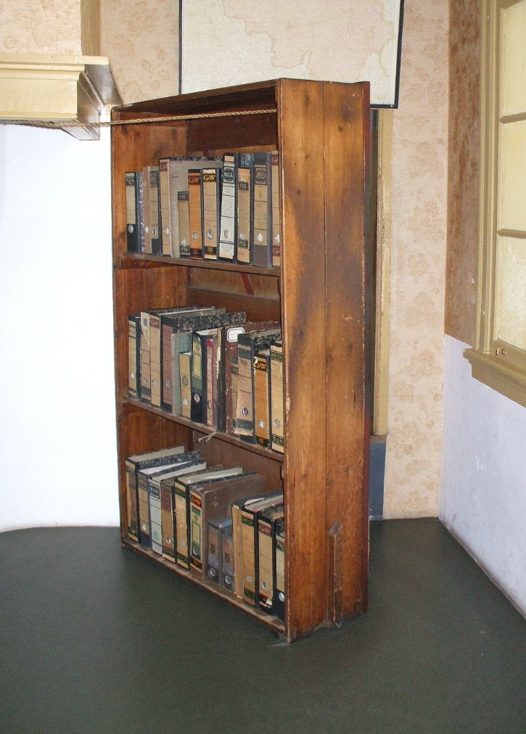

Slide 4
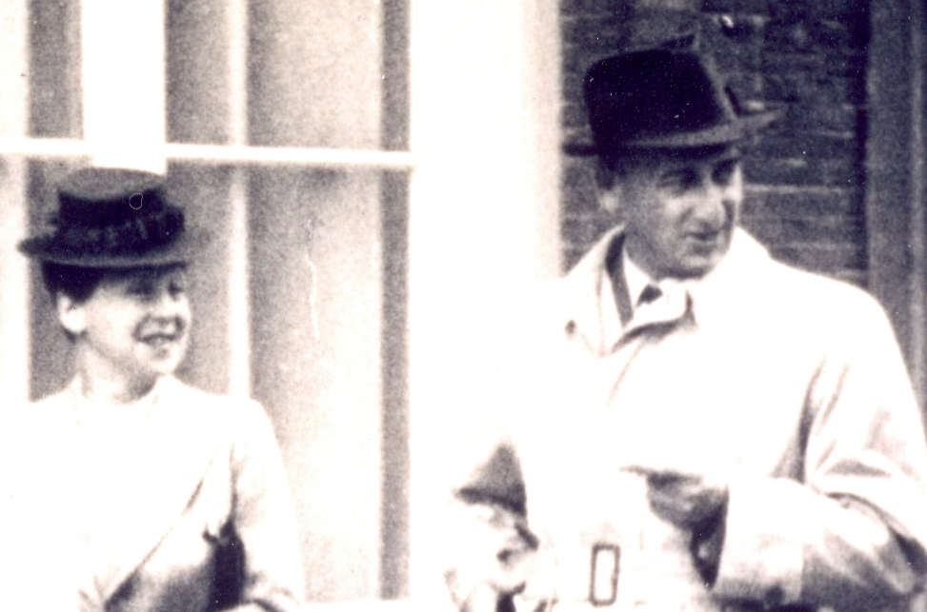
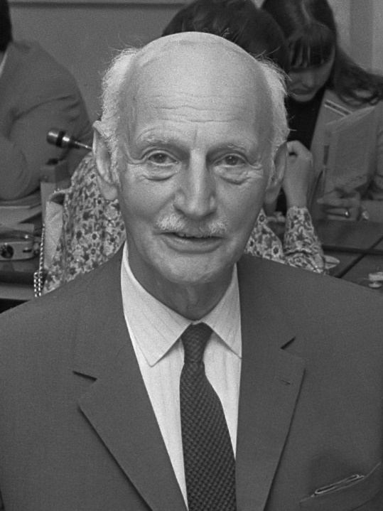
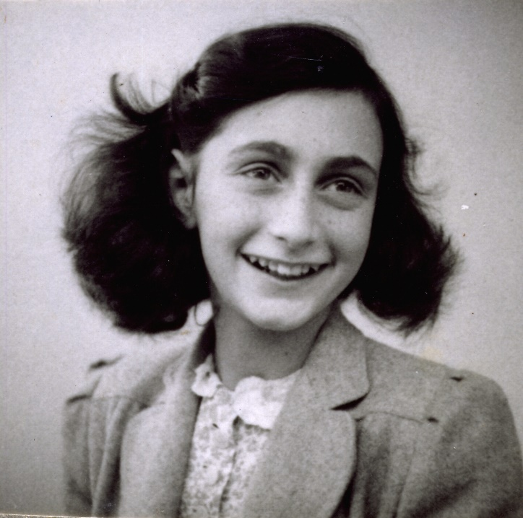
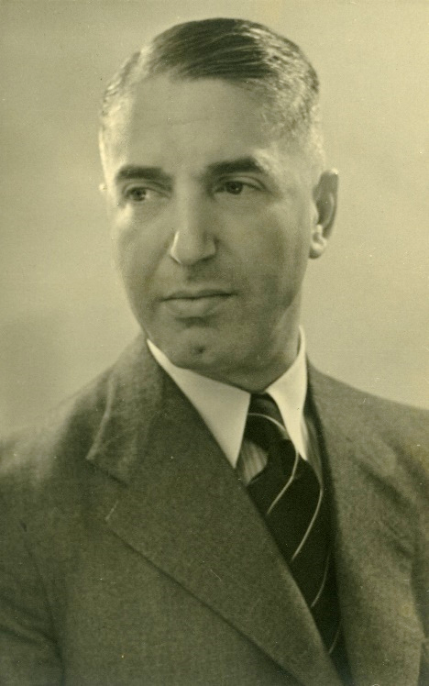
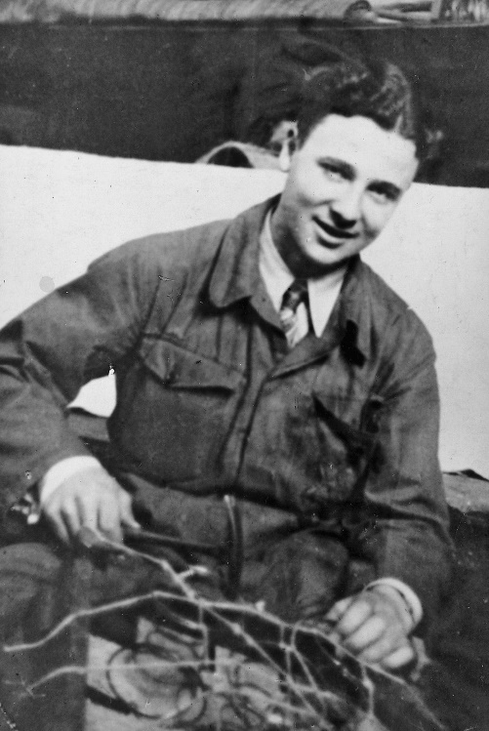
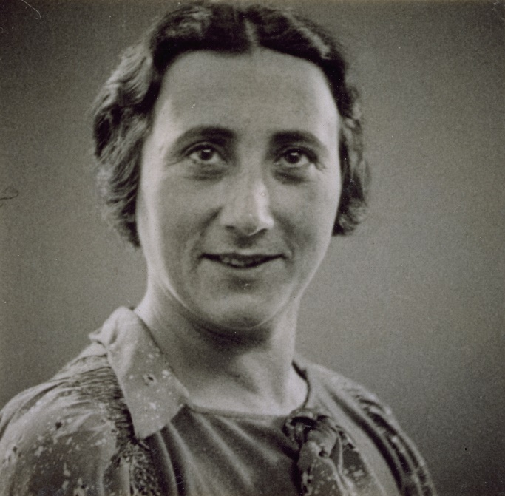
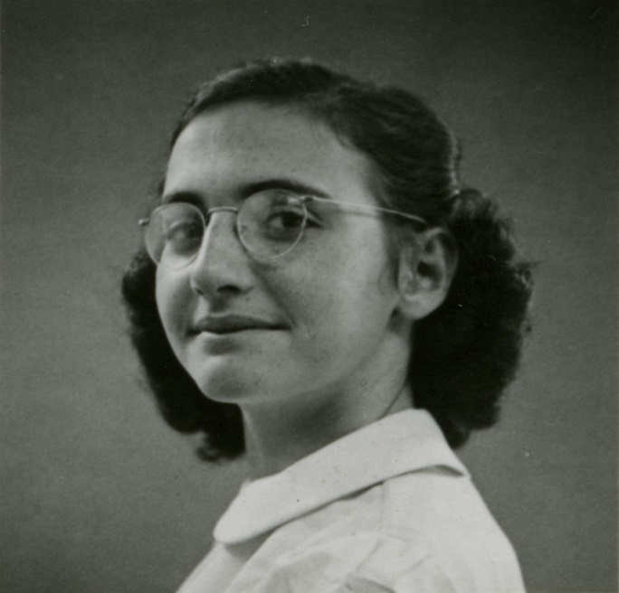
©ANNE FRANK FONDS Basel, Switzerland
Auguste and Hermann van Pels
©ANNE FRANK FONDS Basel, Switzerland
Otto Frank
Anne Frank
©ANNE FRANK FONDS Basel, Switzerland
©ANNE FRANK FONDS Basel, Switzerland
©ANNE FRANK FONDS Basel, Switzerland
©ANNE FRANK FONDS Basel, Switzerland
Fritz Pfeffer
Peter van Pels
Edith Frank
Margot Frank

Slide 6
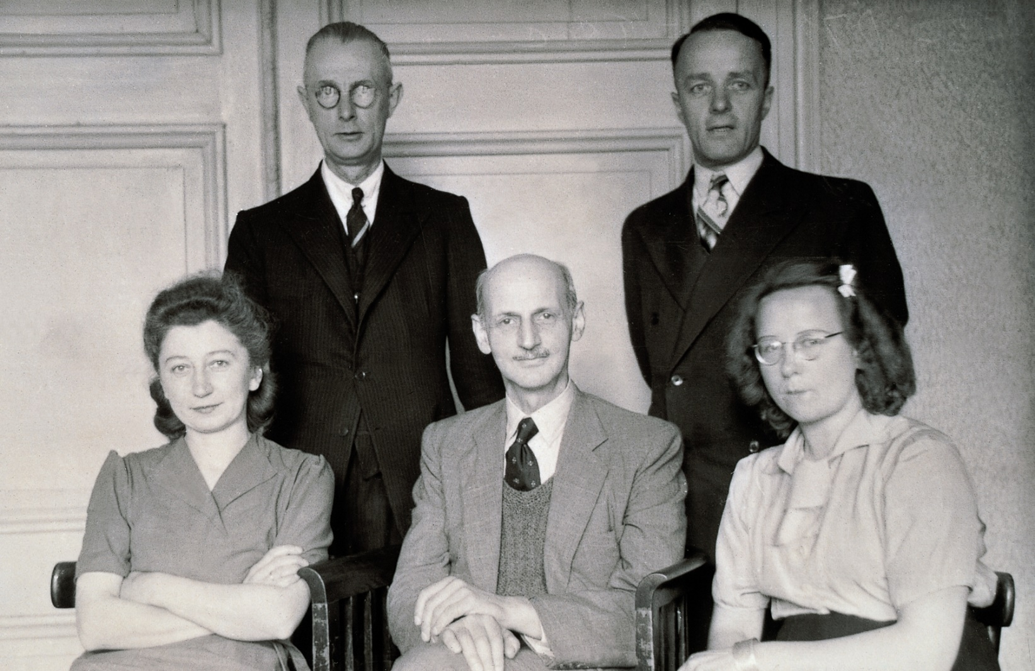
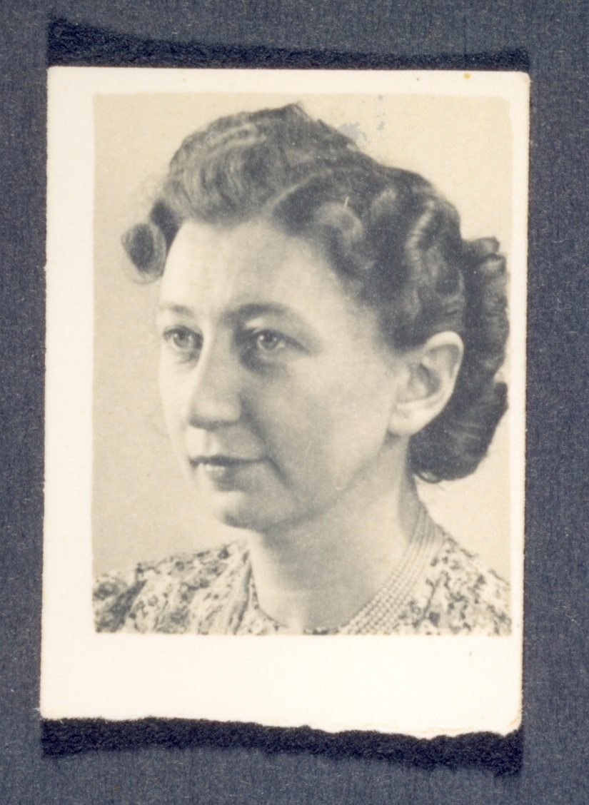
Otto Frank (middle) and his Office Helpers
Miep Gies

Slide 8


Slide 10
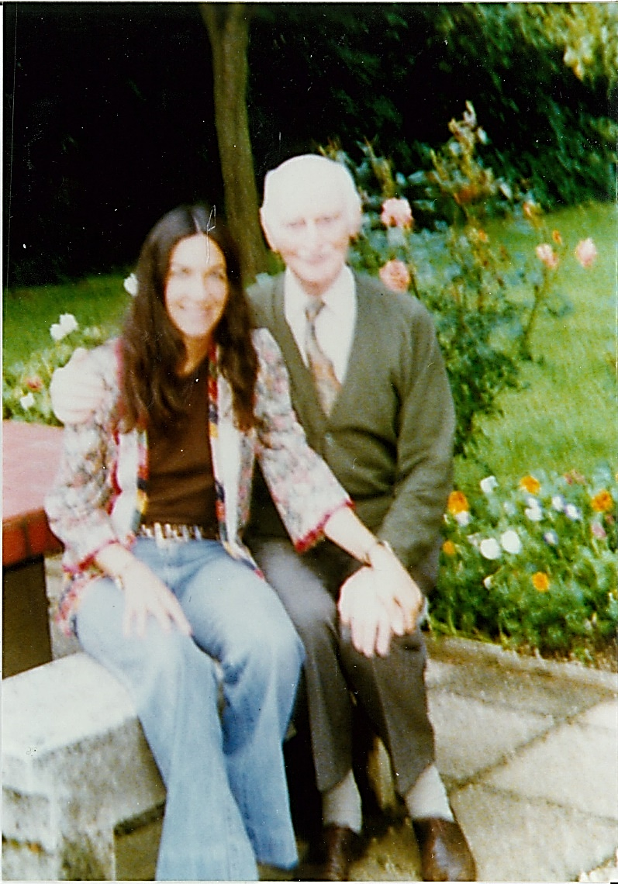
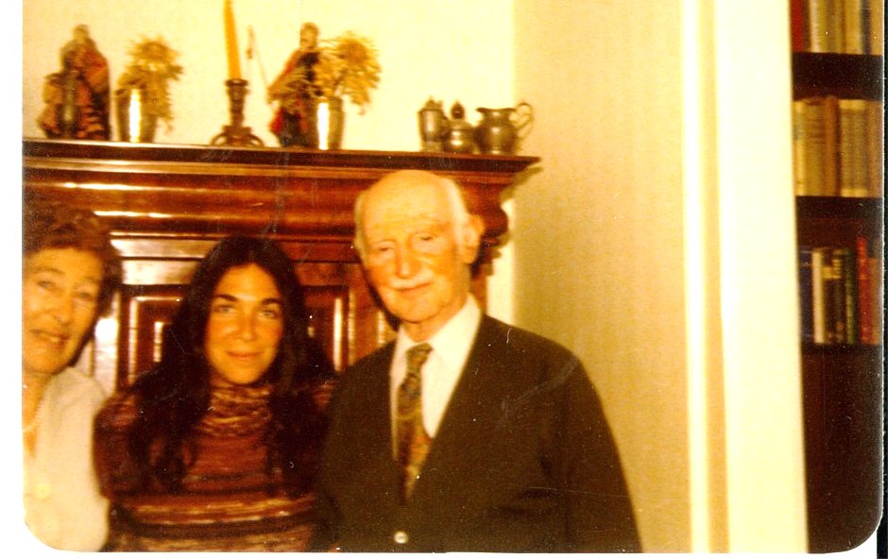
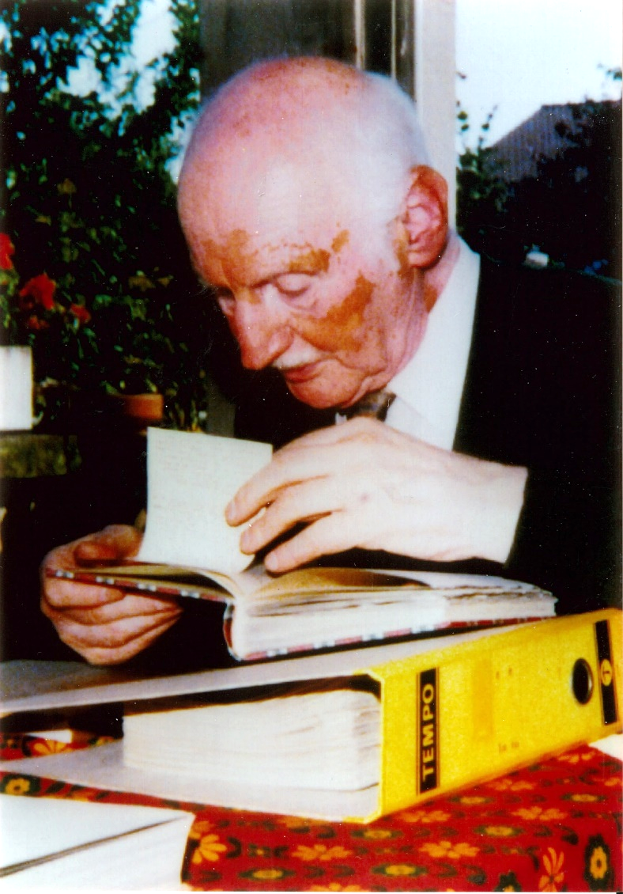
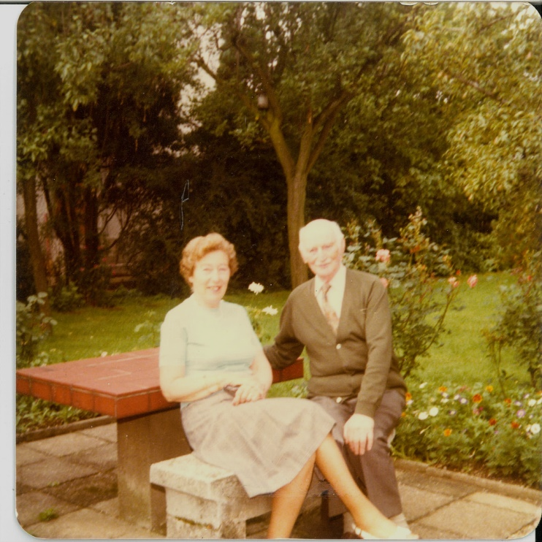
Fritzi, Cara, and Otto
Cara and Otto
Otto at his desk.
Fritzi and Otto

Slide 12
